Slide 1

Market Capitalization and Quarterly Sales Analysis of Top 500 Companies in India
This presentation analyzes the market capitalization and quarterly sales of the top 500 companies in India, providing insights into competitive dynamics and market positioning.

Slide 2

Introduction
1
Objective
The primary objective is to explore the market capitalization and quarterly sales of the top 500 companies in India.
2
Dataset Overview
The dataset is sourced from \[Dataset Link\] and includes crucial financial metrics of prominent companies.
3
Dataset Description
The dataset contains columns for Serial Number, Name, Market Capitalization, and Quarterly Sales.

Slide 3

Data Summary
Total Records
488
Columns Analyzed
Market Capitalization and Quarterly Sales
Average Market Capitalization
28,043.86 Crore
Total Quarterly Sales
1,604,531.55 Crore
Median Market Capitalization
9,885.05 Crore
Median Quarterly Sales
1,278.30 Crore

Slide 4
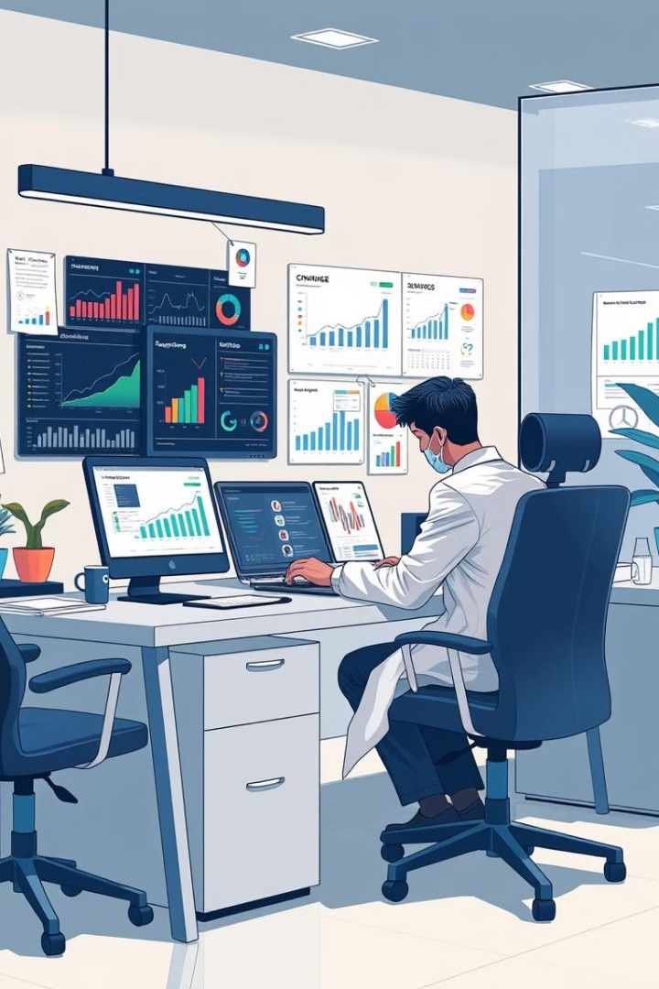
Data Cleaning and Preparation
1
Removal of Unnecessary Columns
The column 'Unnamed: 4' was removed as it contained irrelevant data.
2
Handling Missing Values
Missing values were filled with the placeholder 'Missing' to maintain data integrity.
3
Conversion of Data Types
Columns 'Mar Cap - Crore' and 'Sales Qtr - Crore' were converted to numeric types for accurate analysis.

Slide 5
Descriptive Statistics
Market Capitalization
Quarterly Sales
Count: 479
Count: 365
Mean: 28,043.86 Crore
Mean: 4,395.98 Crore
Standard Deviation: 59,464.62 Crore
Standard Deviation: 11,092.21 Crore
Minimum: 3,017.07 Crore
Minimum: 47.24 Crore
Maximum: 583,436.72 Crore
Maximum: 110,666.93 Crore

Slide 6

Correlation Analysis
Correlation Matrix
Interpretation
Market Capitalization vs. Quarterly Sales: Correlation Coefficient: 0.62
The positive correlation of 0.62 indicates a moderate relationship where higher market capitalization tends to be associated with higher quarterly sales.

Slide 7
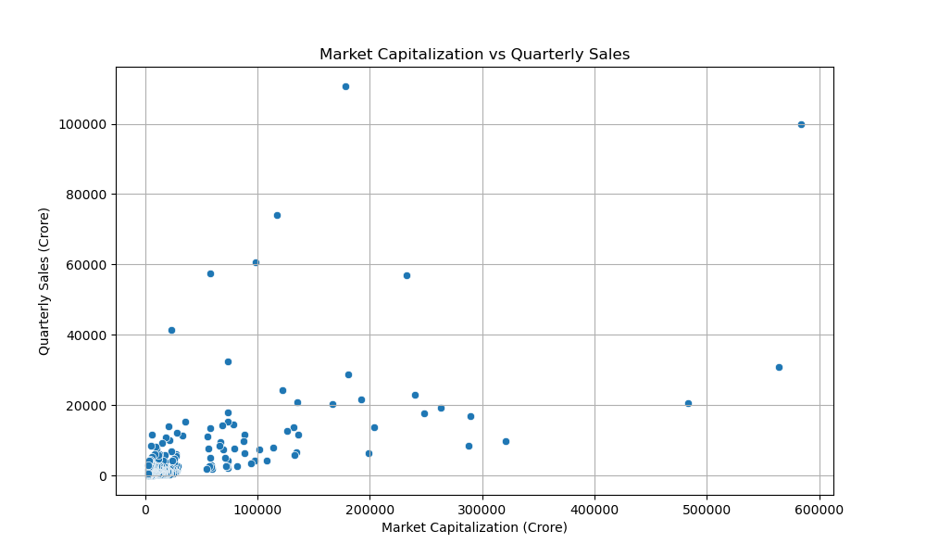
Visualization: Market Capitalization vs. Quarterly Sales
The scatter plot illustrates the relationship between Market Capitalization and Quarterly Sales, showing how the two variables are related across different companies.

Slide 8
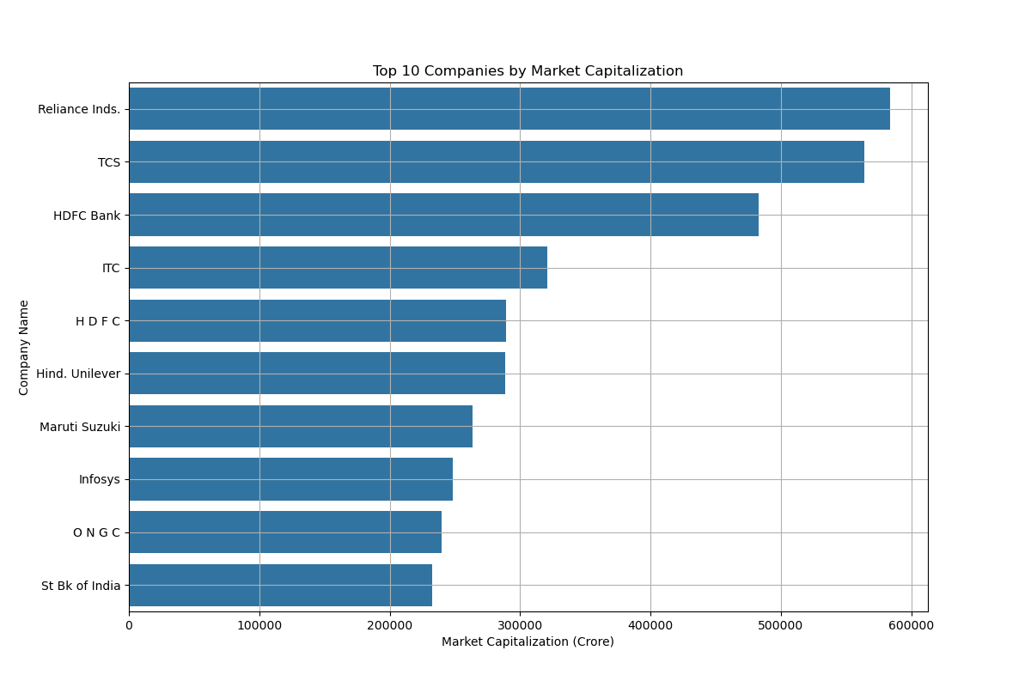

Slide 9
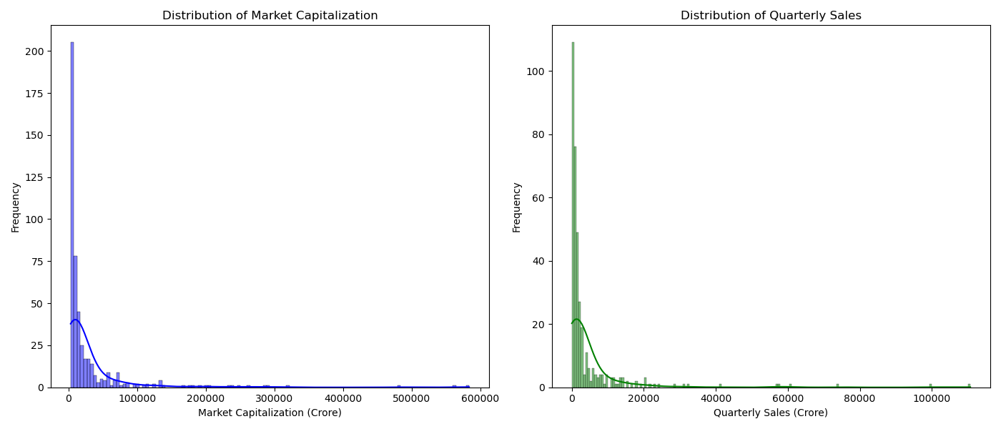

Slide 10
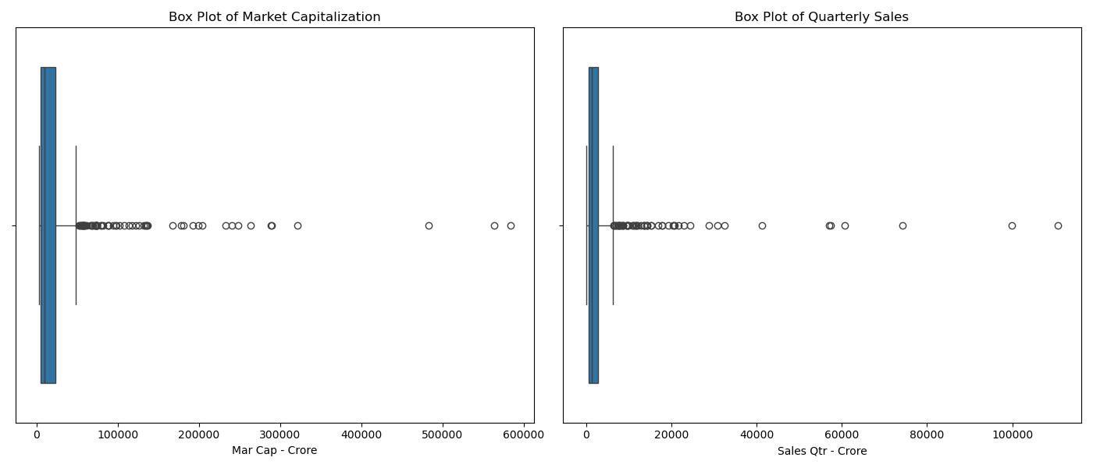

Slide 11
Top 10 Companies by Market Capitalization
Name
Market Capitalization (Crore)
Reliance Inds.
583,436.72
TCS
563,709.84
HDFC Bank
482,953.59
ITC
320,985.27
H D F C
289,497.37
Hind. Unilever
288,265.26
Maruti Suzuki
263,493.81
Infosys
248,320.35
O N G C
239,981.50
St Bk of India
232,763.33

Slide 12





Additional Insights
Average Market Capitalization
28,043.86 Crore
Total Quarterly Sales
1,604,531.55 Crore
Median Market Capitalization
9,885.05 Crore
Median Quarterly Sales
1,278.30 Crore

Slide 13




Findings and Recommendations
Key Findings
Companies with higher market capitalization tend to have higher quarterly sales.
Recommendations
Companies should aim to enhance their market capitalization to drive higher sales and market presence.
Further Research
Additional analysis could explore other factors influencing market capitalization.

